Slide 1
WORKPLACE AND CREATIVITY

Slide 2
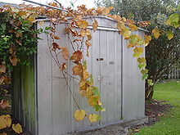
MY WOODSHED

Slide 3
IT’S A TERM WHICH WAS FIRST USED BY JAZZ MUSICIANS TO DESCRIBE A SAFE PLACE WHERE ALL KIND OF EXPERIMENTATION IS POSSIBLE.

Slide 4

JAZZ GREAT CHARLIE PARKER WENT TO THE WOODSHED BEHIND HIS HOUSE SO HE WOULD NOT BE DISTURBED AND INVENTED THE MUSICAL FORM KNOWN AS BEBOP

Slide 5
CREATIVE PLACES

Slide 6
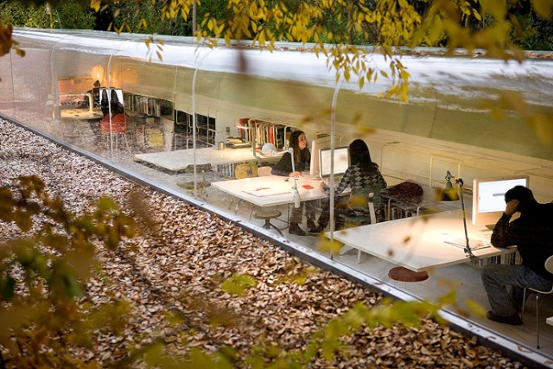

Slide 7
This must be one of the most relaxing offices to work in, because you’re half underground, and half above ground, with views out into the woods. This is Selgas Cano Office, which was designed by Iwan Baan and is situated in a forest, near Madrid, in Spain.

Slide 8
Google thrives of creativity and that thought has very much gone into the reasoning behind the designs of their offices, providing every employee with a space for them to be creative.

Slide 9
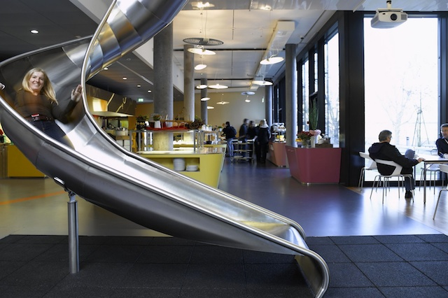
You won’t have to spend all your time walking everywhere as you can just take the slide or fireman’s pole around the building.

Slide 10
There’s a rule at Google that nobody is allowed to be more than 100 meters away from food, so you’ll find kitchens everywhere, as well as an awesome cafeteria where every employee is fed three times a day, for free.

Slide 11
Comvert – Milan, Italy AN alternative clothing company were looking for a new space for their headquarters.

Slide 12
During the search, they happened upon an old abandoned cinema that seemed to offer the perfect solution.

Slide 13
It was big enough to house all of their offices, warehousing and even room a shop in the front, however, there was one ‘problem’,

Slide 14
what would they do with all the extra room above where the audience sat during a movie?

Slide 15
The answer is unique, inspired, and all but simple – build an indoor skate bowl which sat suspended above the warehouse.

Slide 16
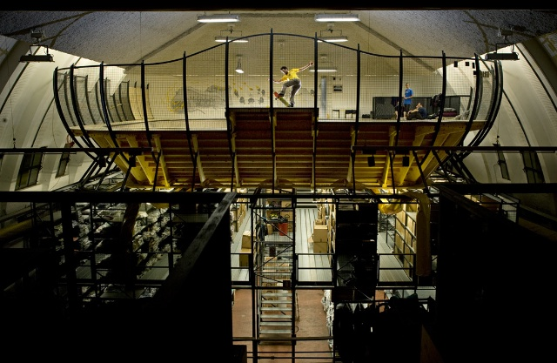

Slide 17
Lego – Denmark

Slide 18
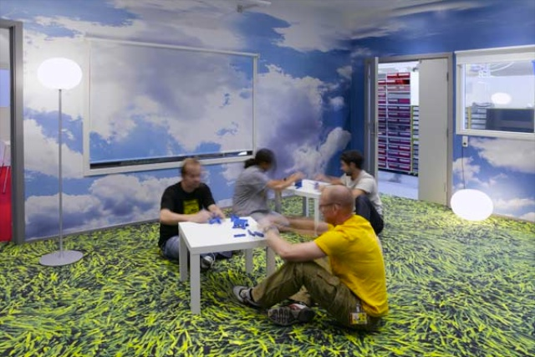

Slide 19
The colourful open-plan layout encourages interaction and play between the staff, in an effort to fuel their imagination, which is what Lego is all about.

Slide 20
Zappos – Las Vegas, Nevada

Slide 21
they’re the world’s largest online shoe retailer.

Slide 22
Zappos have stuck largely to cubicle based design, only they encourage each and every employee to make them their own, with decorations, toys and trinkets.

Slide 23
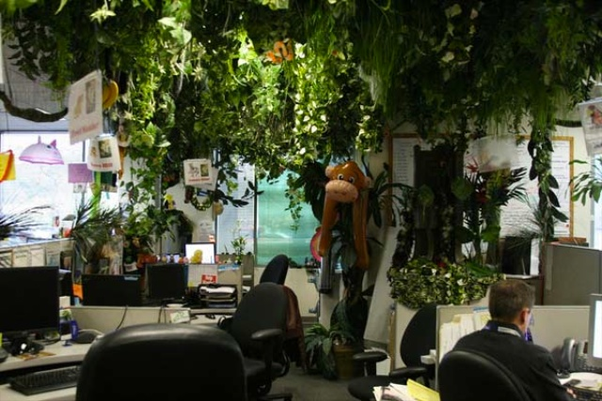

Slide 24
Corus Quay – Toronto, Canada

Slide 25
It’s a massive 500,000 square feet, and home to Corus Entertainment. It’s been labeled Toronto’s smartest building.

Slide 26
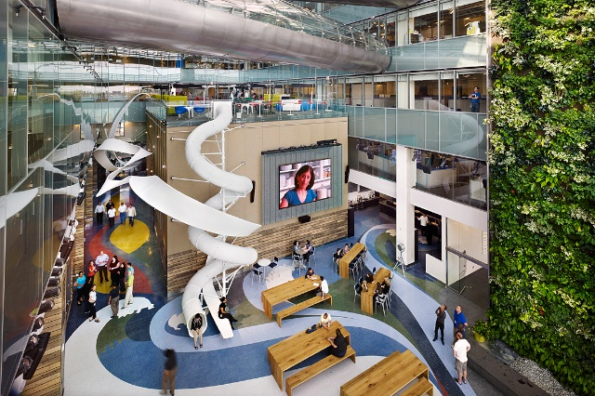

Slide 27
Pallotta TeamWorks is a charitable organisation which specialises in raising money for different needs,

Slide 28
his unique design and fresh colours make for a rather interesting work environment, that’s not just cheap to build, but cheap to run

Slide 29
you see, because this had to be done on such a tight budget, they took to customising a bunch of shipping containers and turning them into office space inside a large warehouse.
.

Slide 30


